Slide 1
Kad Zebras Deg
Bar / RESTAURANT
Computer Science project
DMAI0914 | Group 3

Slide 2
Group 3
Members:
Ionut Danci-Bumbea
Janis Indrans
Leonard Hirja
Nikita Cimaskevic
Richard Retezi

Slide 3

Introduction:
Name: Kad Zebras Deg
Founded: 07.01.2014
Location: Latvia, Riga
Owner and manager: Renars Bents
Type of business: Bar & Restaurant Industry
Translation of logo: Bar “When Zebras Burn”

Slide 4

Planning the project
Unified Processes (UP)
Preliminary Investigation
Inception
Elaboration
Construction
Trello
Scrum

Slide 5

Business Analysis
Interview with the owner
Company description
Investigating the business environment
Implementing business models
Finding key elements, positive and negative features
Business case
Payback Projection

Slide 6

How should we create a system for newly established business?

Slide 7

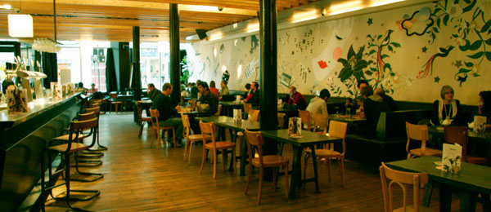
Which tables should waiter book for this company of friends?

Slide 8
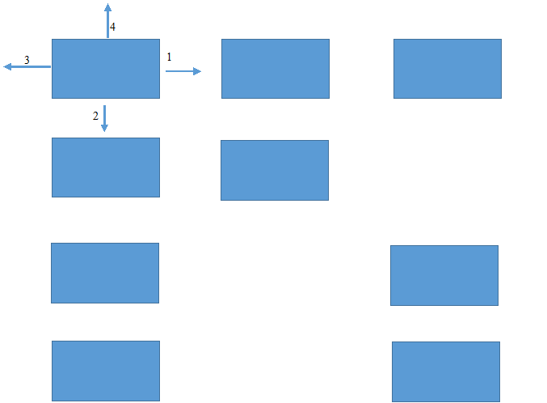
The way of searching for the tables O(n)

Slide 9
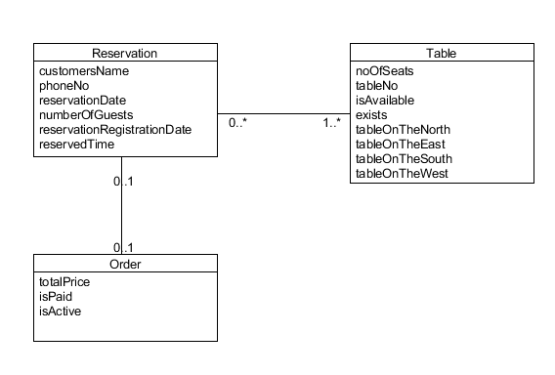
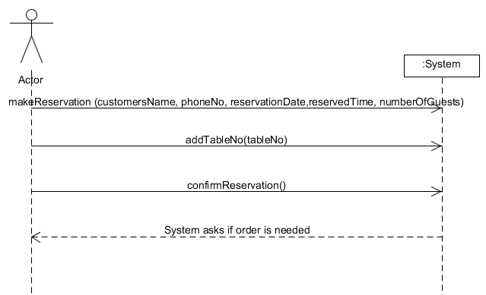
Reservation Use Case
Part Of Domain Model
System Sequence Diagram

Slide 10
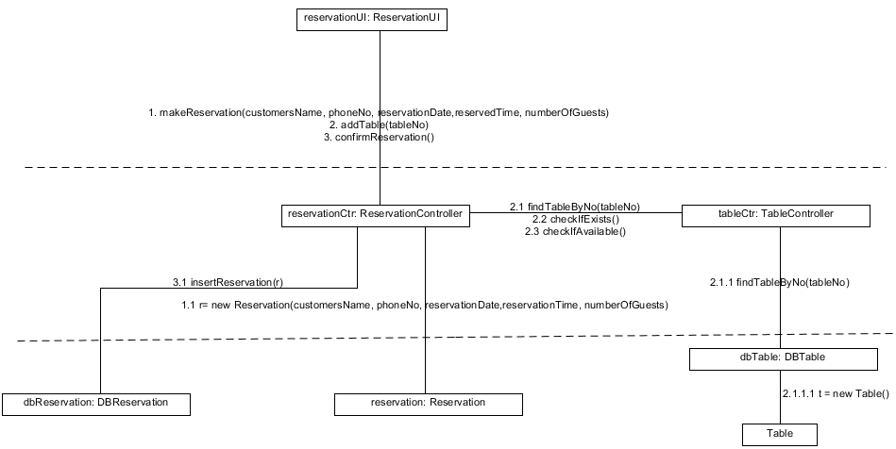
Reservation Use Case
Interaction Diagram

Slide 11
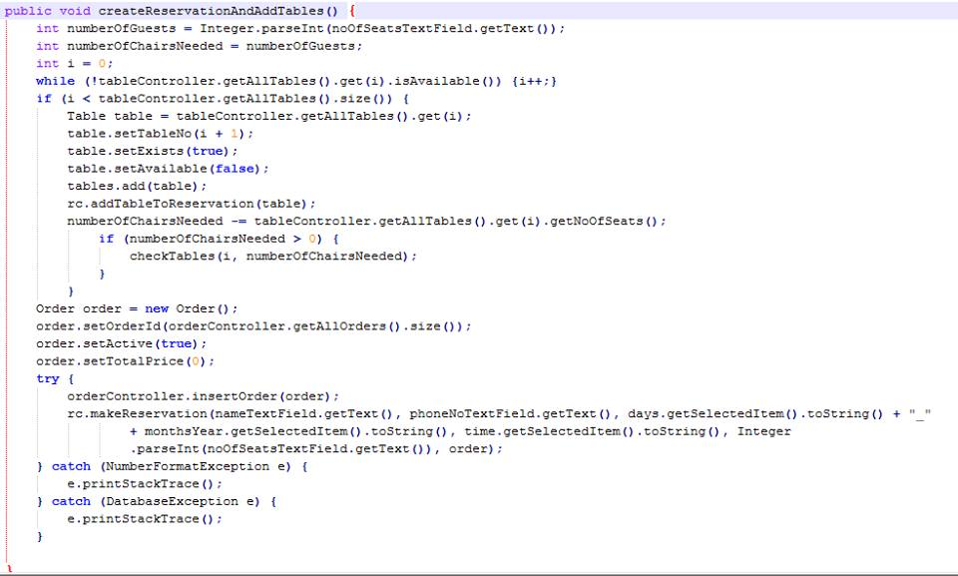
Reservation Use Case
Code part 1

Slide 12
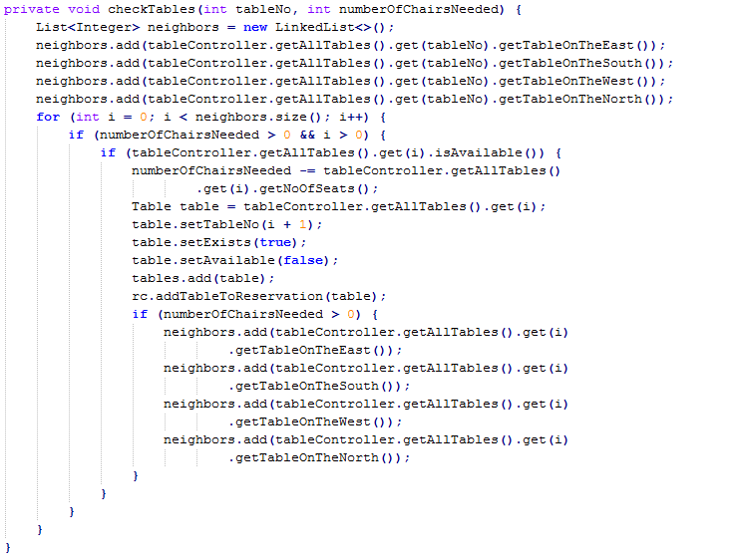
Reservation Use Case
Code part 2

Slide 13

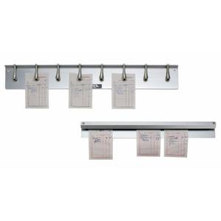
What About The Orders?

Slide 14
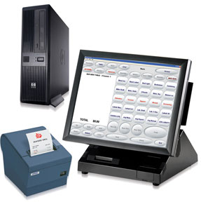

Lets Digitalize this!

Slide 15
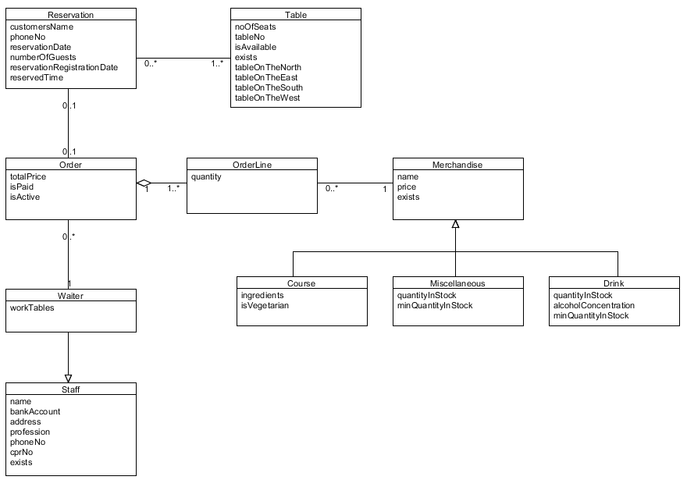
Make Order Use Case
Domain Model

Slide 16
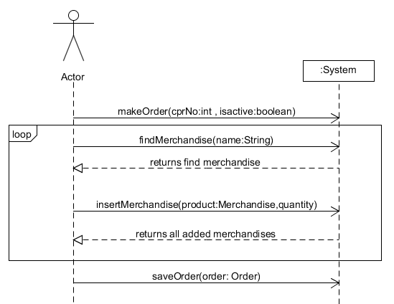
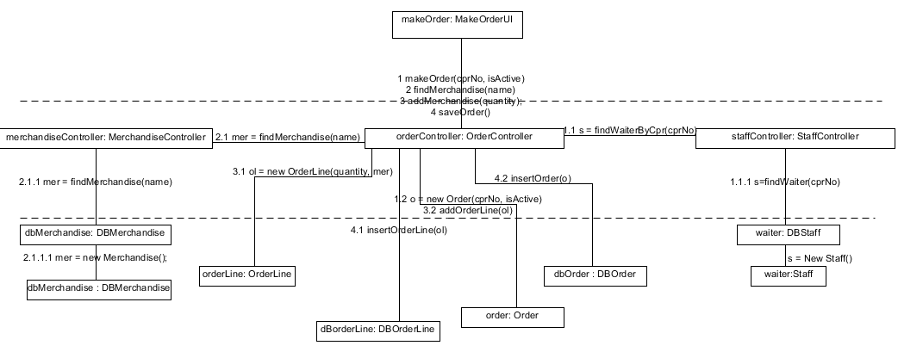
Make Order Use Case
System Sequence Diagram
Interaction Diagram

